Slide 1

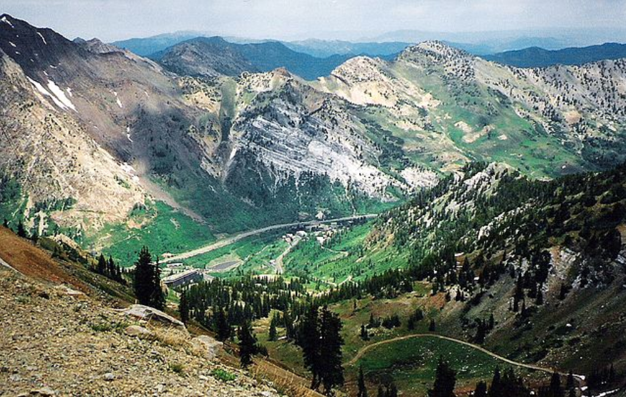
Welcome
2019 International Image Sensor Workshop (IISW)
Snowbird, Utah
June 24th – 27th

Slide 2
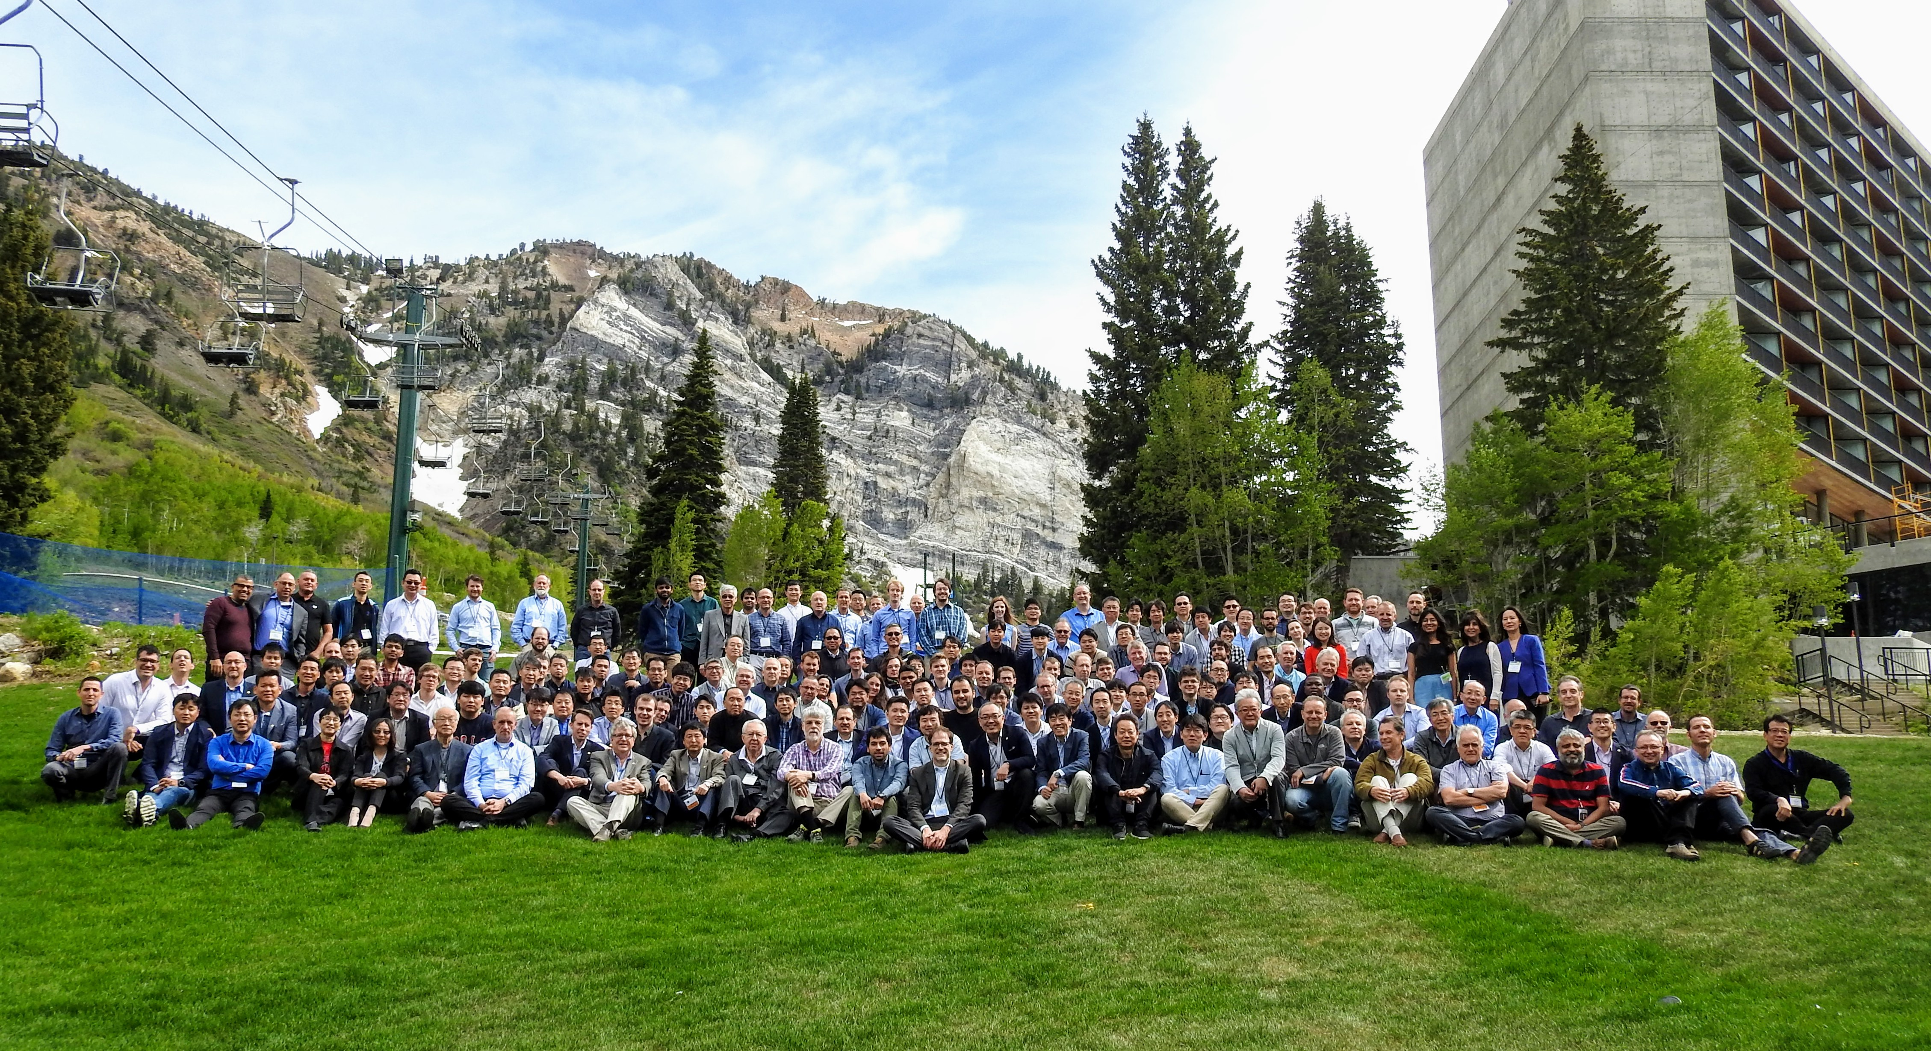
Group Photo – credit Scott Churchwell (again!)

Slide 3


Slide 4
Conference Statistics

Slide 5
Geographic Distribution of Submitted Papers
North Americas – 22%
Europe – 38%
Asia- 40%

Slide 6
Student/Non-student Paper Distribution
Submitted Papers
Accepted Papers
Student Paper- 28%
Student Paper- 28%
Non-student Paper- 72%
Non-student Paper- 72%

Slide 7
Top Organizations of Participation

Slide 8
Submission Timeline

Slide 9
Subject Distribution

Slide 10

Thank You!
Sponsors/Co-sponsors

Slide 11
Introduction
www.imagesensors.org created by Eric Fossum in 2007
Main purpose: library of scientific papers available free of charge
The following slides present latest homepage statistics

Slide 12
IISS homepage statistics

Slide 13
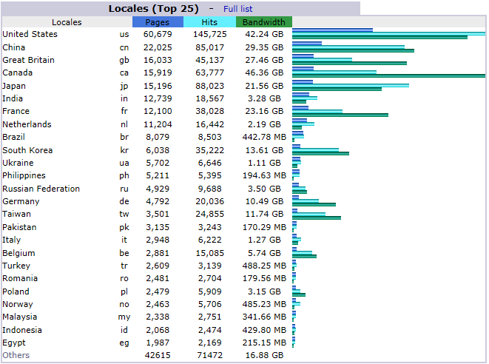
2018 statistics

Slide 14
2018 statistics

Slide 15
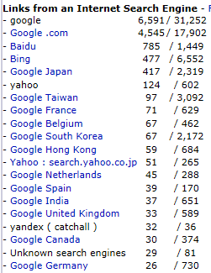
2018 statistics

Slide 16
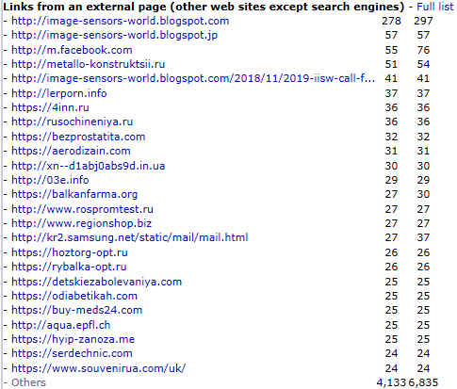
2018 statistics

Slide 17
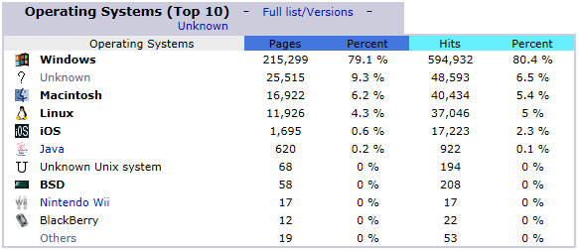
2018 statistics

Slide 18
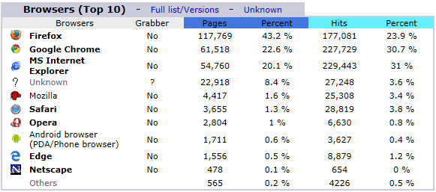
2018 statistics

Slide 19
Remarks
The web site appears to serve the community as intended
What else can we (IISS) do on the website to improve our service to the community?

Slide 20
2019 IISS Awards
Prof. Rihito Kuroda
IISS Awards Committee Chair

Slide 21
2019 IISS Awards
2019 IISW Best Poster Award
2019 IISW Best Student Paper Award
Walter Kosonocky Award
IISS Exceptional Service Award
IISS Pioneering Achievement Award
IISS Exceptional Lifetime Achievement Award

Slide 22
2019 IISW
Best Poster Award
Dr. Vladimir Korobov
Technical Program Chair, 2019 IISW

Slide 23
2019 IISW Best Poster Award
3rd Place:
P19
A 2-Mpixel CMOS Image Sensor with Device Authentication and Encryption Key Generation based on Physically Unclonable Function
Shunsuke Okura , Ryota Ishiki , Syohei Takano ,
Masayoshi Shirahata , Takaya Kubota , Mitsuru Shiozaki ,
Kenichiro Ishikawa , Isao Takayanagi , and Takeshi Fujino
Brillnics Japan Inc., Japan
Ritsumeikan University, Japan

Slide 24
2019 IISW Best Poster Award
2nd Place:
P25
Leakage Current Non-Uniformity and Random Telegraph Signal
in CMOS Image Sensor Floating Diffusions used for In-Pixel Charge Storage
Alexandre Le Roch, Vincent Goiffon, Philippe Paillet,
Jean-Marc Belloir, Pierre Magnan, and Cédric Virmontois
Université de Toulouse, France
Centre Nationale d’Etudes Spatiales (CNES), France
CEA, France

Slide 25
2019 IISW Best Poster Award
1st Place:
P13
Pixel with nested photo diodes and 120 dB single exposure dynamic range
Manuel Innocent, Angel Rodriguez, Deb Guruaribam,
Muhammad Rahman, Marc Sulfridge, Swarnal Borthakur,
Bob Gravelle, Takayuki Goto, Nathan Dougherty, Bill Desjardin, David Sabo, Marko Mlinar and Tomas Geurts
ON Semiconductor, Belgium/USA

Slide 26
IISS
IISS
IISS
IISS
IISS
IISS
IISS
IISS
IISS
IISS
IISS
IISS
IISS
IISS
International Image Sensor Workshop
IISS
IISS
IISS
IISS
IISS
IISS
IISS
IISS
IISS
IISS
IISS
IISS
IISS
IISS
IISS
IISS
Best Poster Award
IISS
IISS
IISS
IISS
IISS
IISS
IISS
IISS
IISS
IISS
IISS
IISS
IISS
IISS
Is presented to
IISS
IISS
IISS
IISS
IISS
IISS
IISS
IISS
IISS
IISS
IISS
IISS
Manuel Innocent
IISS
IISS
IISS
IISS
IISS
IISS
IISS
IISS
IISS
IISS
IISS
IISS
IISS
IISS
For the Poster Titled
Pixel with nested photo diodes and
120 dB single exposure dynamic range
IISS
IISS
IISS
IISS
IISS
IISS
IISS
IISS
IISS
IISS
IISS
IISS
IISS
IISS
IISS
IISS
IISS
IISS
IISS
IISS
IISS
IISS
IISS
IISS
IISS
IISS
IISS
IISS
IISS
IISS
IISS
IISS
IISS
IISS
IISS
IISS
IISS
IISS
IISS
IISS
IISS
IISS
IISS
International Image Sensor Workshop
June 24 - June 27, 2019
Snowbird, USA
IISS
IISS
IISS
IISS
IISS
IISS
IISS
IISS
IISS
IISS
IISS
IISS
IISS
IISS
IISS
IISS
IISS
IISS
IISS
IISS
IISS
IISS
IISS
IISS
IISS
IISS
IISS
________________________
Vladimir Korobov
2019 IISW
Technical Program Chair
IISS
IISS
IISS
IISS
IISS
IISS
IISS
IISS
IISS
IISS
IISS
IISS
IISS
IISS

Slide 27
2019 IISW
Best Student Paper Award
Dr. Vladimir Korobov
Technical Program Chair, 2019 IISW
&
Prof. Rihito Kuroda
IISS Awards Committee Chair

Slide 28
2019 IISW Best Student Paper Award
Newly established in 2019.
Eligible papers: written and presented (either oral or poster) by students with full-time enrollment at the time of abstract submission.
Winner: one winner is selected for each workshop.
Selection: based on the quality of abstracts and presentations judged by TPC members.
About 5 papers are nominated based on the quality of abstracts, and the quality of presentations are graded during the workshop.

Slide 29
2019 IISW Best Student Paper Award Final Nominees
No. | Author | Paper Title
R07 | Wei Deng et al., Dartmouth College | Modelling Measured 1/f Noise in Quanta Image Sensors (QIS)
R15 | Yuya Shirakawa et al., Shizuoka University. | An 8-tap CMOS Lock-in Pixel Image Sensor for Short-Pulse Time-of-Flight Measurements
R20 | Tarek Al Abbas et al., University of Edinburgh | Dual Layer 3D-Stacked High Dynamic Range SPAD Pixel
R21 | Kiyotaka iwabuchi et al., Tokyo University of Science. | Iterative image reconstruction for quanta image sensor by using variance-based motion estimation
R27 | Preethi Padmanabhan et al., EPFL | Analysis of a modular SPAD-based direct time-of-flight depth sensor architecture for wide dynamic range scenes in a LiDAR system
R36 | Manabu Suzuki et al., Tohoku University | Over 100 Million Frames per Second 368 Frames Global Shutter Burst CMOS Image Sensor with In-pixel Trench Capacitor Memory Array
R44 | Epimitheas Georgitzikis et al., imec, KU Leuven | Organic- and QD-based image sensors integrated on 0.13 μm CMOS ROIC for high resolution, multispectral infrared imaging
R45 | Yhang Ricardo Sipauba Carvalho da Silva et al., Tohoku University | A VGA Optical Filter-less CMOS Image Sensor with UV-selective and Visible Light Channels by Differential Spectral Response Pixels

Slide 30
2019 IISW Best Student Paper Award
R27 - Analysis of a modular SPAD-based direct time-of-flight depth sensor architecture for wide dynamic range scenes in a LiDAR system
Preethi Padmanabhan, Chao Zhang and Edoardo Charbon
EPFL, TU Delft.
R44 - A VGA Optical Filter-less CMOS Image Sensor with UV-selective and Visible Light Channels by Differential Spectral Response Pixels
Yhang Ricardo Sipauba Carvalho da Silva, Rihito Kuroda and Shigetoshi Sugawa
Tohoku University

Slide 31
IISS
IISS
IISS
IISS
IISS
IISS
IISS
IISS
IISS
IISS
IISS
IISS
IISS
IISS
International Image Sensor Workshop
IISS
IISS
IISS
IISS
IISS
IISS
IISS
IISS
IISS
IISS
IISS
IISS
IISS
IISS
IISS
Best Student Paper Award
IISS
IISS
IISS
IISS
IISS
IISS
IISS
IISS
IISS
IISS
IISS
IISS
IISS
IISS
IISS
Is presented to
IISS
IISS
IISS
IISS
IISS
IISS
IISS
IISS
IISS
IISS
IISS
IISS
Preethi Padmanabhan
IISS
IISS
IISS
IISS
IISS
IISS
IISS
IISS
IISS
IISS
IISS
IISS
IISS
IISS
For the Paper Titled
IISS
IISS
IISS
IISS
IISS
IISS
IISS
IISS
IISS
IISS
IISS
IISS
IISS
IISS
Analysis of a modular SPAD-based direct
time-of-flight depth sensor architecture for wide dynamic range scenes in a LiDAR system
IISS
IISS
IISS
IISS
IISS
IISS
IISS
IISS
IISS
IISS
IISS
IISS
IISS
IISS
IISS
IISS
IISS
IISS
IISS
IISS
IISS
IISS
IISS
IISS
IISS
IISS
IISS
IISS
IISS
International Image Sensor Workshop
June 24 - June 27, 2019
Snowbird, USA
IISS
IISS
IISS
IISS
IISS
IISS
IISS
IISS
IISS
IISS
IISS
IISS
IISS
IISS
IISS
IISS
IISS
IISS
IISS
IISS
IISS
IISS
IISS
IISS
IISS
IISS
IISS
________________________
Vladimir Korobov
2019 IISW
Technical Program Chair
________________________
Rihito Kuroda
Director
Awards Chair
IISS
IISS
IISS
IISS
IISS
IISS
IISS
IISS
IISS
IISS
IISS
IISS
IISS
IISS

Slide 32
IISS
IISS
IISS
IISS
IISS
IISS
IISS
IISS
IISS
IISS
IISS
IISS
IISS
IISS
International Image Sensor Workshop
IISS
IISS
IISS
IISS
IISS
IISS
IISS
IISS
IISS
IISS
IISS
IISS
IISS
IISS
IISS
Best Student Paper Award
IISS
IISS
IISS
IISS
IISS
IISS
IISS
IISS
IISS
IISS
IISS
IISS
IISS
IISS
IISS
Is presented to
IISS
IISS
IISS
IISS
IISS
IISS
IISS
IISS
IISS
IISS
IISS
IISS
Yhang Ricardo Sipauba Carvalho da Silva
IISS
IISS
IISS
IISS
IISS
IISS
IISS
IISS
IISS
IISS
IISS
IISS
IISS
IISS
For the Paper Titled
IISS
IISS
IISS
IISS
IISS
IISS
IISS
IISS
IISS
IISS
IISS
IISS
IISS
IISS
A VGA Optical Filter-less CMOS Image Sensor with UV-selective and Visible Light Channels by Differential Spectral Response Pixels
IISS
IISS
IISS
IISS
IISS
IISS
IISS
IISS
IISS
IISS
IISS
IISS
IISS
IISS
IISS
IISS
IISS
IISS
IISS
IISS
IISS
IISS
IISS
IISS
IISS
IISS
IISS
IISS
IISS
International Image Sensor Workshop
June 24 - June 27, 2019
Snowbird, USA
IISS
IISS
IISS
IISS
IISS
IISS
IISS
IISS
IISS
IISS
IISS
IISS
IISS
IISS
IISS
IISS
IISS
IISS
IISS
IISS
IISS
IISS
IISS
IISS
IISS
IISS
IISS
________________________
Vladimir Korobov
2019 IISW
Technical Program Chair
________________________
Rihito Kuroda
Director
Awards Chair
IISS
IISS
IISS
IISS
IISS
IISS
IISS
IISS
IISS
IISS
IISS
IISS
IISS
IISS

Slide 33
2019 Walter Kosonocky Award
Prof. Rihito Kuroda
IISS Awards Committee Chair
&
Prof. Albert Theuwissen
IISS President

Slide 34
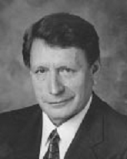
The 11th Walter Kosonocky Award for Significant Advancement in
Solid-State Image Sensors
The Walter Kosonocky Award is presented biennially for THE BEST PAPER presented in any venue during the prior two years representing significant advancement in solid-state image sensors. The award commemorates the many important contributions made by the late Dr. Walter Kosonocky to the field of solid-state image sensors.
Founded in 1997 by his colleagues in industry, government and academia, the award is also funded by proceeds from the International Image Sensor Workshop. The award committee, comprised of the IISW technical program committee, solicits nominations biennially. The award is announced and presented at the Workshop. It includes a cash award of US$2,500.

Slide 35
Walter Kosonocky Award (WKA)
The IISS Awards committee solicits nominations biennially.
Nominated papers are scored by the current IISW Technical Program Committee.
  A committee member is NOT allowed to score a paper by his/her organization and/or collaborating organizations.
  The conflict-of-interest rule also extends two years into the past.
The scores are used to select the winning paper.

Slide 36
Walter Kosonocky Award
Past Recipients
1999 | Jan Bosiers, et al. | Philips | A 2/3” 2M pixel progressive scan FT-CCD for digital still camera applications
2001 | Tetsuo Yamada, et al. | FujiFilm | A Progressive Scan CCD Image Sensor for DSC Applications
2003 | Jaroslav Hynecek | Texas Instruments | Impactron – A New Solid State Image Intensifier
2005 | Alex Krymski et al. | Micron | A 2 Electron noise, 1.3. Megapixel CMOS Sensor
2007 | Satoshi Yoshihara, et al. | Sony | A 1/1.8” 6.4 Mpixel 60 frames/s CMOS image sensor with seamless mode change
2009 | Eric Stevens, et al. | Eastman Kodak | Low Crosstalk and Low Dark Current CMOS Image Sensor Technology Using a Hole-Based Detector

Slide 37
Walter Kosonocky Award
Past Recipients (Cont.)
2011 | Hayato Wakabayashi, et al. | Sony | A 1/2.3-inch 10.3Mpixel 50 frame/s Back-Illuminated CMOS Image Sensor
2013 | Kazuya Kitamura, et al. | NHK Shizuoka University | A 33-Megapixel 120-Frames-Per-Second 2.5-Watt CMOS Image Sensor With Column-Parallel Two-Stage Cyclic Analog-to-Digital Converters
2015 | Shunichi Sukegawa, et al. | Sony | A 1/4-inch 8Mpixel Back-Illuminated Stacked CMOS Image Sensor
2017 | Cyrus S. Bamji, et al. | Microsoft | A 0.13 μm CMOS System-on-Chip for a 512 × 424 Time-of-Flight Image Sensor With Multi-Frequency Photo-Demodulation up to 130 MHz and 2 GS/s ADC

Slide 38
2019 WKA
11 Nominated Papers
“1Mpixel 65nm BSI 320MHz Demodulated ToF Image Sensor with 3.5µm Global Shutter Pixels and Analog Binning,” C. Bamji, S. Mehta, B. Thompson, T. Elkhatib, S. Wurster, O. Akkaya et al., ISSCC 2018, pp.94-95, February, 2018.
“320 x 240 Back-Illuminated 10 µm CAPD Pixels for High-Speed Modulation Time-of-Flight CMOS Image Sensor,” Y. Kato, T. Sano, Y. Moriyama, S. Maeda, T. Yamazaki, A. Nose et al., IEEE Journal of Solid-State Circuits, Vol.53, pp. 1071-1078, April 2018.
“A 1.8e-rms temporal noise over 110-dB-dynamic range 3.4 µm pixel pitch global-shutter CMOS image sensor with dual-gain amplifiers SS-ADC, light guide structure and multiple-accumulation shutter,” M. Kobayashi, Y. Onuki, K. Kawabata, H. Sekine, T. Tsuboi, T. Muto et al., IEEE Journal of Solid-State Circuits, Vol.53, pp.219-228, January, 2018.
“A 1/2.3inch 20Mpixel 3-Layer Stacked CMOS Image Sensor with DRAM,” T. Haruta, T. Nakajima, J. Hashizume, T. Umebayashi, H. Takahashi, K. Taniguchi, et al., ISSCC 2017, pp.76-77, February, 2017.

Slide 39
2019 WKA
11 Nominated Papers (Cont.)
“A 30-frames/s, 252 x 144 SPAD Flash LiDAR With 1728 Dual-Clock 48.8-ps TDCs, and Pixel-Wise Integrated Histogramming,” C. Zhang, S. Lindner, I. M. Antolović, J. M. Pavia, M. Wolf, E. Charbon, IEEE Journal of Solid-State Circuits, Vol.54, No.4, pp.1137-1151, December, 2018.
“A 6.9-um pixel-pitch back-illuminated global shutter CMOS image sensor with pixel-parallel 14-bit subthreshold ADC,” M. Sakakibara, K. Ogawa, S. Sakai, Y. Tochigi, K. Honda, H. Kikuchi, et al., IEEE J. Solid-State Circuits, Vol.53, No.11, pp.3017-3025, November, 2018.
“A HDR 98dB 3.2μm Charge Domain Global Shutter CMOS Image Sensor,” A. Tournier, F. Roy, Y. Cazaux, F. Lalanne, P. Malinge, M. Mcdonald, G. Monnot, N. Roux, IEDM Tech. Dig., pp.229-232, December, 2018.
“A Stacked CMOS Image Sensor With Array-Parallel ADC Architecture,” T. Takahashi, Y. Kaji, Y. Tsukuda, S. Futami, K. Hanzawa, T. Yamauchi et al., IEEE Journal of Solid-State Circuits, Vol.53, pp.1061-1070, April 2018.

Slide 40
2019 WKA
11 Nominated Papers (Cont.)
“IR sensitivity enhancement of CMOS Image Sensor with diffractive light trapping pixels,” S. Yokogawa, I. Oshiyama, H. Ikeda, Y. Ebiko, T. Hirano, S. Saito et al., Scientific Reports, Vol.7, Article No.3832, pp.1-9, June 2017.
“Photon-number-resolving megapixel image sensor at room temperature without avalanche gain,” J. Ma, S. Masoodian, D. A. Starkey, and E. R. Fossum, Optica Vol.4, No.12, pp.1474-1481, November, 2017.
“Random Telegraph Noise Pixel Classification and Time Constant Extraction for a 1.1μm Pitch 8.3MP CMOS Image Sensor,” C. Chao, H. Tu, T. Wu, K.-Y. Chou, S.-F. Yeh, and F.-L. Hsueh, IISW2017, pp. 35-38, May, 2017.

Slide 41
2019 WKA Goes To
“IR sensitivity enhancement of CMOS Image Sensor with diffractive light trapping pixels”
Sozo Yokogawa, Itaru Oshiyama, Harumi Ikeda, Yoshiki Ebiko,
Tomoyuki Hirano, Suguru Saito, Takashi Oinoue, Yoshiya Hagimoto and Hayato Iwamoto
Sony Semiconductor Solutions, Japan
Scientific Reports, Vol. 7, Abstract No. 3832, pp.1-9, June 2017.
Congratulations!

Slide 42
IISS
IISS
IISS
IISS
IISS
IISS
IISS
IISS
IISS
IISS
IISS
IISS
IISS
IISS
International Image Sensor Society
IISS
IISS
IISS
IISS
IISS
IISS
IISS
IISS
IISS
IISS
IISS
IISS
IISS
IISS
IISS
Walter Kosonocky Award
IISS
IISS
IISS
IISS
IISS
IISS
IISS
IISS
IISS
IISS
IISS
IISS
IISS
IISS
IISS
Is presented to
IISS
IISS
IISS
IISS
IISS
IISS
IISS
IISS
IISS
IISS
IISS
IISS
Sozo Yokogawa
IISS
IISS
IISS
IISS
IISS
IISS
IISS
IISS
IISS
IISS
IISS
IISS
IISS
IISS
For the Paper Titled
IISS
IISS
IISS
IISS
IISS
IISS
IISS
IISS
IISS
IISS
IISS
IISS
IISS
IISS
IR sensitivity enhancement of CMOS Image Sensor with diffractive light trapping pixels
Scientific Reports, Vol. 7, Article No. 3832, pp. 1-9, June 2017
IISS
IISS
IISS
IISS
IISS
IISS
IISS
IISS
IISS
IISS
IISS
IISS
IISS
IISS
IISS
IISS
IISS
IISS
IISS
IISS
IISS
IISS
IISS
IISS
IISS
IISS
IISS
IISS
International Image Sensor Workshop
June 24 - June 27, 2019
Snowbird, USA
IISS
IISS
IISS
IISS
IISS
IISS
IISS
IISS
IISS
IISS
IISS
IISS
IISS
IISS
IISS
IISS
IISS
IISS
IISS
IISS
IISS
IISS
IISS
IISS
IISS
IISS
IISS
IISS
________________________
Albert Theuwissen
Director
President
________________________
Daniel Van Blerkom
Director
Workshop Co-Chair
________________________
Yibing Michelle Wang
Director
Workshop Co-Chair
________________________
Rihito Kuroda
Director
Awards Chair
IISS
IISS
IISS
IISS
IISS
IISS
IISS
IISS
IISS
IISS
IISS
IISS
IISS
IISS

Slide 43
IISS Exceptional Service Award
Prof. Nobukazu Teranishi
IISS Director
and
Prof. Albert Thuwissen
IISS President

Slide 44
IISS Exceptional Service Award
This award is to recognize a person who made an exceptional service to the image sensor specialist community, established in 2011.
- US$ 2,500 cash award
- Complimentary IISW registration

Slide 45


IISS Exceptional Service Award
Past Recipients
2011 Dr. Vladimir Koifman
For the creation and continuing editorship of Image Sensors World Blog.
2013 Prof. Albert Theuwissen
For exceptional contributions to the education of image sensor specialists through your books, university teaching, organization of various educational activities in conjunction with IEEE and IISS meetings, and continuing professional education with Harvest Imaging.

Slide 46
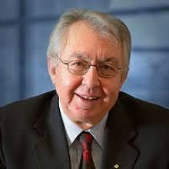
IISS Exceptional Service Award
2019 Recipient
Dr. Savvas Chamberlain,
“For the Contributions to the Organization of What is Now the International Image Sensor Workshop”

Slide 47
IISS Exceptional Service Award
2019 Recipient
The Workshops in the early days
1st: 1986 IEEE Workshop on CCD,
Arden House, New York, USA
2nd: 1990 IEEE Workshop on Advanced Solid-State Imagers,
Arden House, New York, USA
3rd: 1991 IEEE CCD Workshop,
Waterloo, Canada (Chair of the Steering and TPC)
4th: 1993 IEEE Workshop on CCDs and Advanced Image Sensors,
Waterloo, Canada (General Chair)
5th: 1995 IEEE Workshop on CCDs and Advanced Image Sensors,
Dana Point, California, USA (Organizer)
During this period, the Workshop grew substantially
and the workshop organization was established!

Slide 48

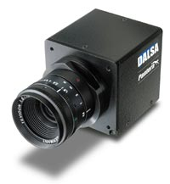
IISS Exceptional Service Award
2019 Recipient
Well-known as the founder of DALSA.
Image sensor design and image sensor /camera manufacturing
Savvas led its growth to a 1,000-employee company.

Slide 49
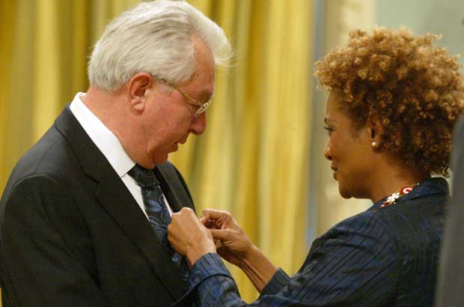
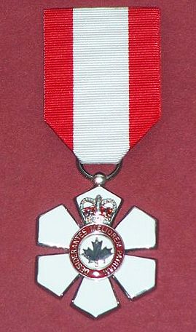
IISS Exceptional Service Award
2019 Recipient
Dr. Savvas Chamberlain,
C.M., FRSC., M.Sc., Ph.D., D.Eng., FIEEE, FCAE, FCEI.
Member of the Order of Canada
Distinguished Professor Emeritus of Univ. of Waterloo
CEO and Chairman, EXEL Research Inc
Members of the Order of
Canada, C. M. in 2009
Notes:
The Order of Canada is this country's highest distinction, recognizing a lifetime of outstanding achievement, dedication to the community and service to the nation. It will be presented to Dr. Chamberlain at a special investiture to be held at a later date.

Slide 50
IISS
IISS
IISS
IISS
IISS
IISS
IISS
IISS
IISS
IISS
IISS
IISS
IISS
IISS
International Image Sensor Society
IISS
IISS
IISS
IISS
IISS
IISS
IISS
IISS
IISS
IISS
IISS
IISS
IISS
IISS
IISS
Exceptional Service Award
IISS
IISS
IISS
IISS
IISS
IISS
IISS
IISS
IISS
IISS
IISS
IISS
IISS
IISS
IISS
Is presented to
IISS
IISS
IISS
IISS
IISS
IISS
IISS
IISS
IISS
IISS
IISS
IISS
Savvas Chamberlain
IISS
IISS
IISS
IISS
IISS
IISS
IISS
IISS
IISS
IISS
IISS
IISS
IISS
IISS
For
IISS
IISS
IISS
IISS
IISS
IISS
IISS
IISS
IISS
IISS
IISS
IISS
IISS
IISS
Contributions to the Organization of What is Now the International Image Sensor Workshop
IISS
IISS
IISS
IISS
IISS
IISS
IISS
IISS
IISS
IISS
IISS
IISS
IISS
IISS
IISS
IISS
IISS
IISS
IISS
IISS
IISS
IISS
IISS
IISS
IISS
IISS
IISS
IISS
International Image Sensor Workshop
June 24 - June 27, 2019
Snowbird, USA
IISS
IISS
IISS
IISS
IISS
IISS
IISS
IISS
IISS
IISS
IISS
IISS
IISS
IISS
IISS
IISS
IISS
IISS
IISS
IISS
IISS
IISS
IISS
IISS
IISS
IISS
IISS
IISS
________________________
Albert Theuwissen
Director
President
________________________
Daniel Van Blerkom
Director
Workshop Co-Chair
________________________
Yibing Michelle Wang
Director
Workshop Co-Chair
________________________
Rihito Kuroda
Director
Awards Chair
IISS
IISS
IISS
IISS
IISS
IISS
IISS
IISS
IISS
IISS
IISS
IISS
IISS
IISS

Slide 51
IISS
Pioneering Achievement Award
Prof. Eric Fossum
IISS Director
&
Prof. Albert Theuwissen
IISS President

Slide 52

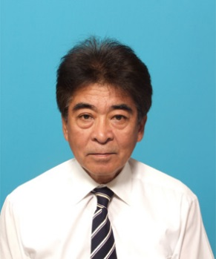
2019 IISS Pioneering Achievement Award
This award is to recognize a person who made a pioneering achievement in image sensor technology, and judged by at least 10 years of hindsight as a foundational contribution. (Established 2015)
  US$3,000 cash award
  Complimentary IISW registration
Past Recipients
2015 |  | Peter JW Noble | For seminal contributions to early years of MOS image sensors
2017 |  | Tetsuo Yamada | For contribution to R&D and commercialization of high-performance and high-resolution CCD image sensors

Slide 53
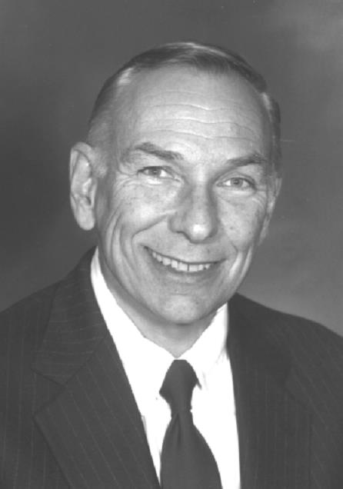
2019 IISS Pioneering Achievement Award
Marvin White
for development of the Correlated Double Sampling (CDS) noise reduction technique for image sensors
In the early 1970’s, soon after the invention of the CCD image sensor, there was great interest in low-light cameras using CCDs. At Westinghouse, Dr. Marvin White was working on low-light CCDs. So-called kTC noise on the output node was limiting the low light performance. Marvin said he borrowed the general idea of double-sampling from radar signal processing at Westinghouse and applied it to CCD signal processing.
Since then Correlated Double Sampling (CDS) has been a mainstay in CCD signal processing to reduce noise and spawned the use of other noise-reduction strategies like DDS, CMS in both analog and digital domains. Probably every CCD and CIS made since the early 1970’s up through the present has employed CDS.

Slide 54
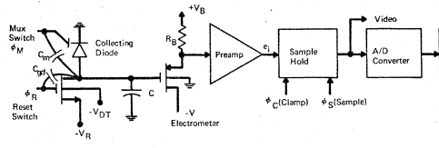
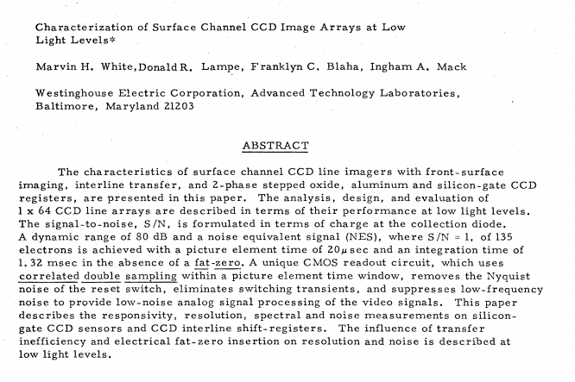
1973 CCD Applications Conference, San Diego, CA

Slide 55
2019 IISS Pioneering Achievement Award
Prof. Marvin White
Sherman-Fairchild Professor of Electrical and Computer Engineering and director of the Sherman-Fairchild Center for Solid State Studies at Lehigh Univ until 2010.
He has authored or co-authored nearly 300 technical papers, contributed chapters to four books and has 27 U.S. patents. At Lehigh, he graduated 34 PhD and 62 MS students.
Currently with Ohio State University and still teaching.
Honors:
  U.S. National Academy of Engineering
  IEEE Life Fellow
  Distinguished National Lecturer of the IEEE Electron Devices Society.
  IEEE Electron Devices Society’s 1997 J. J. Ebers
  IEEE 2000 Masaru Ibuka Consumer Electronics Award.
https://ethw.org/Oral-History:Marvin_White

Slide 56
IISS
IISS
IISS
IISS
IISS
IISS
IISS
IISS
IISS
IISS
IISS
IISS
IISS
IISS
International Image Sensor Society
IISS
IISS
IISS
IISS
IISS
IISS
IISS
IISS
IISS
IISS
IISS
IISS
IISS
IISS
IISS
Pioneering Achievement Award
IISS
IISS
IISS
IISS
IISS
IISS
IISS
IISS
IISS
IISS
IISS
IISS
IISS
IISS
IISS
Is presented to
IISS
IISS
IISS
IISS
IISS
IISS
IISS
IISS
IISS
IISS
IISS
IISS
Marvin H. White
IISS
IISS
IISS
IISS
IISS
IISS
IISS
IISS
IISS
IISS
IISS
IISS
IISS
IISS
For
IISS
IISS
IISS
IISS
IISS
IISS
IISS
IISS
IISS
IISS
IISS
IISS
IISS
IISS
Development of the Correlated Double Sampling (CDS) Noise Reduction Technique for Image Sensors
IISS
IISS
IISS
IISS
IISS
IISS
IISS
IISS
IISS
IISS
IISS
IISS
IISS
IISS
IISS
IISS
IISS
IISS
IISS
IISS
IISS
IISS
IISS
IISS
IISS
IISS
IISS
IISS
International Image Sensor Workshop
June 24 - June 27, 2019
Snowbird, USA
IISS
IISS
IISS
IISS
IISS
IISS
IISS
IISS
IISS
IISS
IISS
IISS
IISS
IISS
IISS
IISS
IISS
IISS
IISS
IISS
IISS
IISS
IISS
IISS
IISS
IISS
IISS
IISS
________________________
Albert Theuwissen
Director
President
________________________
Daniel Van Blerkom
Director
Workshop Co-Chair
________________________
Yibing Michelle Wang
Director
Workshop Co-Chair
________________________
Rihito Kuroda
Director
Awards Chair
IISS
IISS
IISS
IISS
IISS
IISS
IISS
IISS
IISS
IISS
IISS
IISS
IISS
IISS

Slide 57
IISS Exceptional
Lifetime Achievement Award
Prof. Albert Thuwissen
IISS President

Slide 58
IISS Exceptional
Lifetime Achievement Award
Presented for exceptional service to the image sensor specialist community. Established in 2011.

Slide 59
IISS Exceptional
Lifetime Achievement Award
This Award is made to a member of the image sensor community who has made substantial sustained and exceptional contributions to the field of solid-state image sensors over the course of their career.
US$3,500 cash award
Complimentary IISW registration
The first recipient : Gene P. Weckler (2013)
The second recipient : Dr. Jaroslav Hynecek (2015)
Third recipient : Yasuo Ishihara (2017)

Slide 60
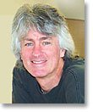
IISS Exceptional
Lifetime Achievement Award
James (Jim) R. Janesick
“Contributions to the Characterization and Improvement of Scientific Image Sensors, including Development of
the Widely-Used Photon-Transfer Technique”

Slide 61
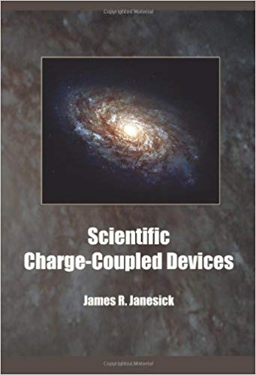
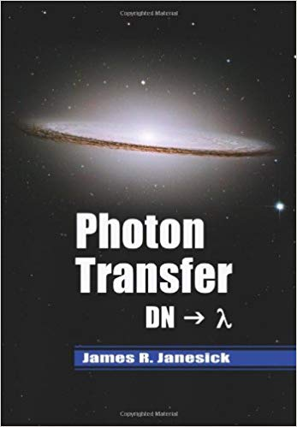
IISS Exceptional
Lifetime Achievement Award
Jim is known and recognized for :
The development of the Skipper CCD,
The development of the Notch CCD,
The development of the Open pinned-phase CCD,
The development of UV flooding as back-side passivation,
Writing the text book “Scientific Charge-Coupled Devices”,
But especially for his Contributions to the characterization of solid-state image sensors (CCD and CMOS), that resulted in the widely used Photon Transfer Curve Technique or PTC ! The latter landed as well in a text book “Photon Transfer”.

Slide 62
IISS Exceptional
Lifetime Achievement Award
Jim is also known but not recognized for :
Playing in a rock band (the Tangents) that reached the US top 40 in the sixties,
Being the best and daily customer of Taco Bell in Huntington Beach,
Performing sensor measurements while wearing a biking helmet (because he forgot to put it off),
Still working 7/7 on imagers at the age of 72,
Not attending any conference or workshop,
Hating to travel and not being here.

Slide 63
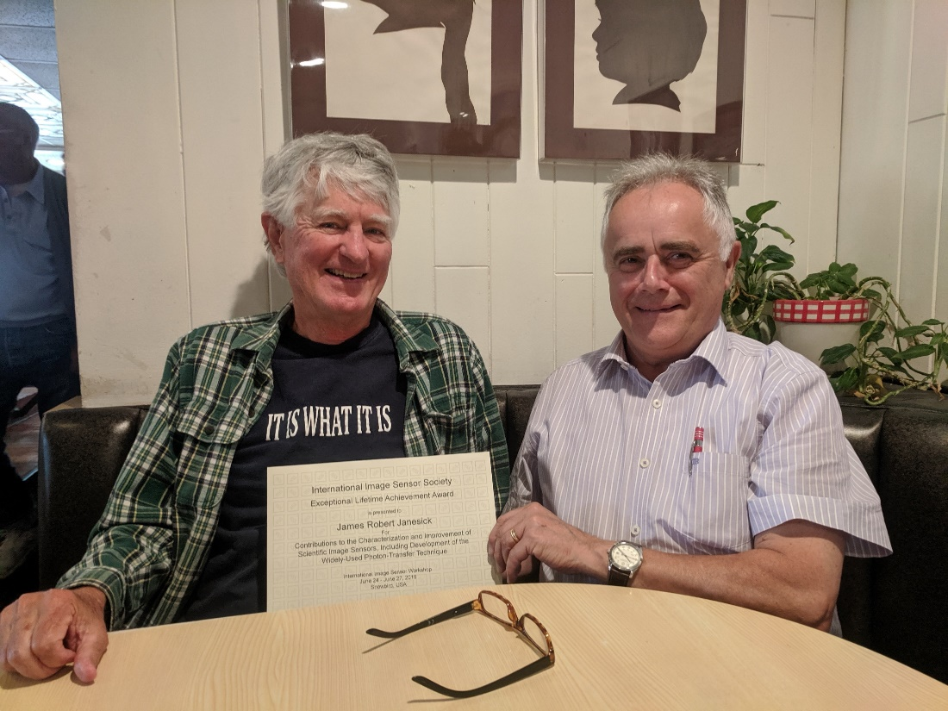
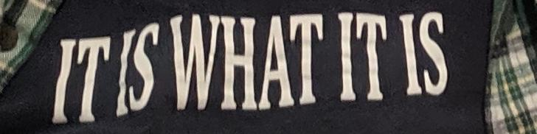
IISS Exceptional
Lifetime Achievement Award
But if Moses cannot go to the mountain, then we bring the mountain to Moses. Last Saturday a visit was paid to Jim’s home place to handover the certificate.

Slide 64
IISS
IISS
IISS
IISS
IISS
IISS
IISS
IISS
IISS
IISS
IISS
IISS
IISS
IISS
International Image Sensor Society
IISS
IISS
IISS
IISS
IISS
IISS
IISS
IISS
IISS
IISS
IISS
IISS
IISS
IISS
Exceptional Lifetime Achievement Award
IISS
IISS
IISS
IISS
IISS
IISS
IISS
IISS
IISS
IISS
IISS
IISS
IISS
IISS
IISS
IISS
Is presented to
IISS
IISS
IISS
IISS
IISS
IISS
IISS
IISS
IISS
IISS
IISS
IISS
James Robert Janesick
IISS
IISS
IISS
IISS
IISS
IISS
IISS
IISS
IISS
IISS
IISS
IISS
IISS
IISS
For
Contributions to the Characterization and Improvement of Scientific Image Sensors, Including Development of the Widely-Used Photon-Transfer Technique
IISS
IISS
IISS
IISS
IISS
IISS
IISS
IISS
IISS
IISS
IISS
IISS
IISS
IISS
IISS
IISS
IISS
IISS
IISS
IISS
IISS
IISS
IISS
IISS
IISS
IISS
IISS
IISS
IISS
IISS
IISS
IISS
IISS
IISS
IISS
IISS
IISS
IISS
IISS
IISS
IISS
IISS
International Image Sensor Workshop
June 24 - June 27, 2019
Snowbird, USA
IISS
IISS
IISS
IISS
IISS
IISS
IISS
IISS
IISS
IISS
IISS
IISS
IISS
IISS
IISS
IISS
IISS
IISS
IISS
IISS
IISS
IISS
IISS
IISS
IISS
IISS
IISS
IISS
________________________
Albert Theuwissen
Director
President
________________________
Daniel Van Blerkom
Director
Workshop Co-Chair
________________________
Yibing Michelle Wang
Director
Workshop Co-Chair
________________________
Rihito Kuroda
Director
Awards Chair
IISS
IISS
IISS
IISS
IISS
IISS
IISS
IISS
IISS
IISS
IISS
IISS
IISS
IISS

Slide 65
  EOF

Slide 66
Group Photo – credit Scott Churchwell (again!)

