Slide 1
Introduction
www.imagesensors.org created by Eric Fossum in 2007
Main purpose: library of scientific papers available free of charge
The following slides present latest homepage statistics

Slide 2
IISS homepage statistics

Slide 3
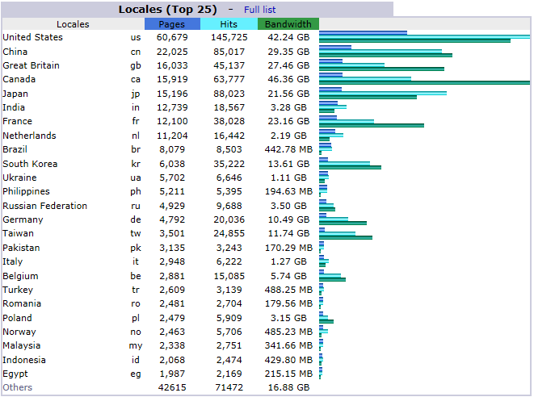
2018 statistics

Slide 4
2018 statistics

Slide 5
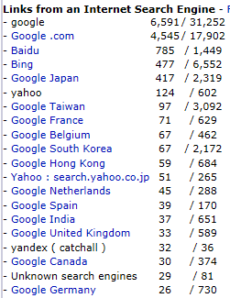
2018 statistics

Slide 6
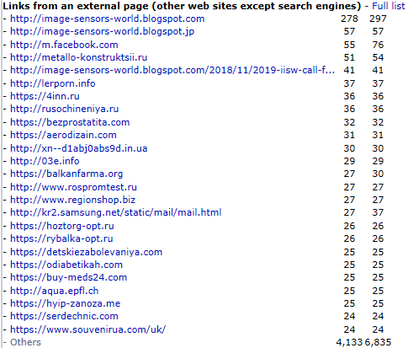
2018 statistics

Slide 7
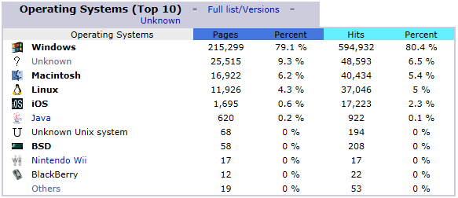
2018 statistics

Slide 8
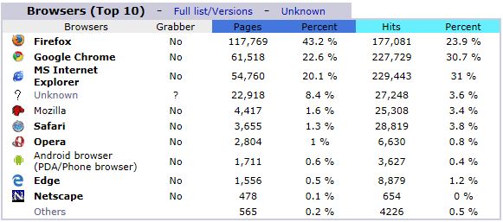
2018 statistics

Slide 9
Closing remarks
The web site appears to serve the community as intended
What else can we (IISS) do on the website to improve our service to the community?

