Slide 1


Planar microlenses for SPAD sensors

Slide 2

outline
Introduction
  SPAD array and melted microlens
  Towards planar microlenses
Planar microlenses
  Theory basics
  Process
  Simulations
  Characterization results
Conclusion

Slide 3
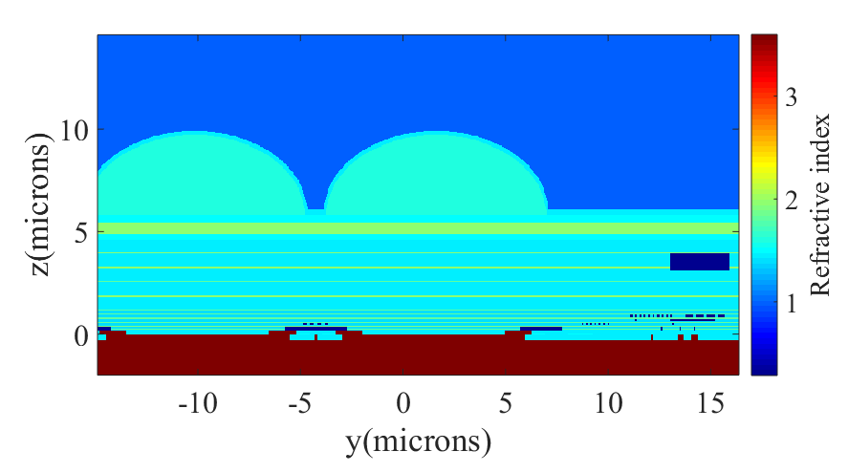
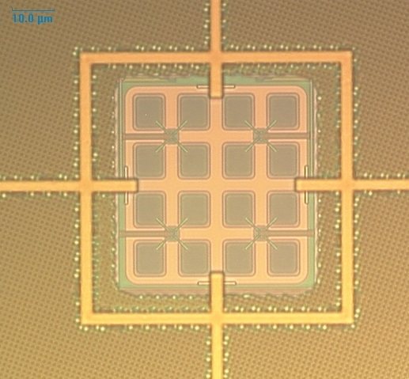
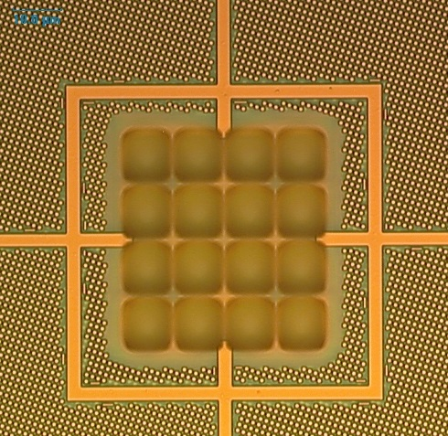
introduction
SPAD array with standard melted microlens
  4x4 SPADs pixels 10.18 µm pitch to form a macropixel
  STMicroelectronics C40 CMOS technology
Macropixel without microlens (ff_{O} ~ 40%)
Macropixel with melted microlens
Cross-section of 2 SPAD pixels with melted microlens [3]
Metal shielding
Fill-factor +30% [2]
Light-collecting surface
Pixel surface
[1] G. Intermite et al, Enhancing the Fill-Factor of CMOS SPAD Arrays Using Microlens Integration, Proceedings of SPIE, Vol. 9504 (2015).
[2] S. Pellegrini, International SPAD Sensor Workshop (2018).
[3] High-Performance Nanophotonic Simulation Software, http://www.lumerical.com/.

Slide 4
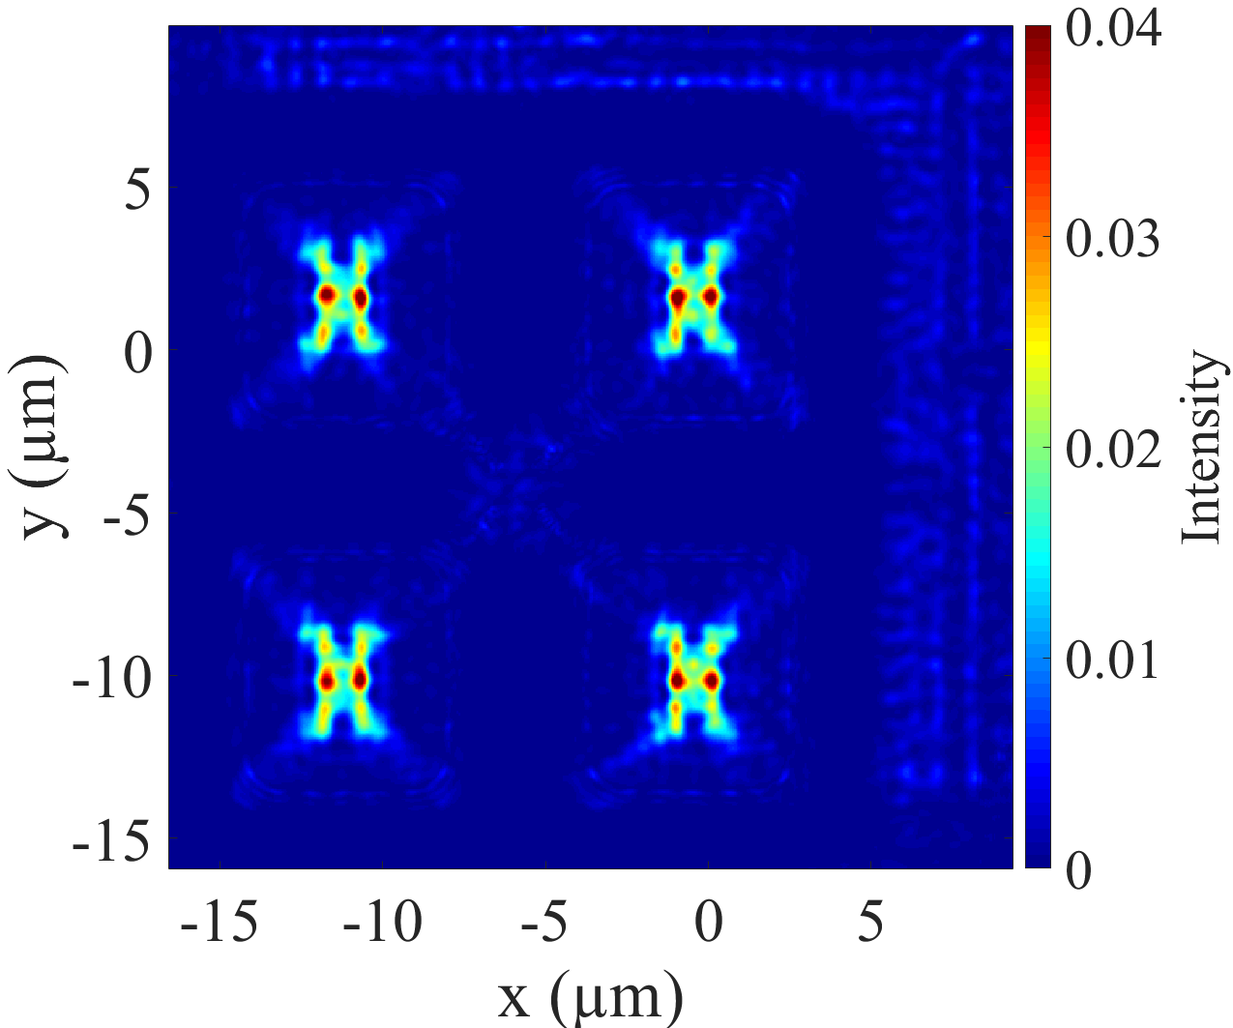
introduction
SPAD array with standard melted microlens
  4x4 SPADs pixels 10.18 µm pitch to form a macropixel
  STMicroelectronics C40 CMOS technology
Macropixel without microlens (ff_{O} ~ 40%)
Macropixel with melted microlens
Cross-section of 2 SPAD pixels with melted microlens [3]
FDTD calculation of light intensity at Si entrance [3]
Metal shielding
Fill-factor +30% [2]
Light-collecting surface
Pixel surface
[1] G. Intermite et al, Enhancing the Fill-Factor of CMOS SPAD Arrays Using Microlens Integration, Proceedings of SPIE, Vol. 9504 (2015).
[2] S. Pellegrini, International SPAD Sensor Workshop (2018).
[3] High-Performance Nanophotonic Simulation Software, http://www.lumerical.com/.

Slide 5
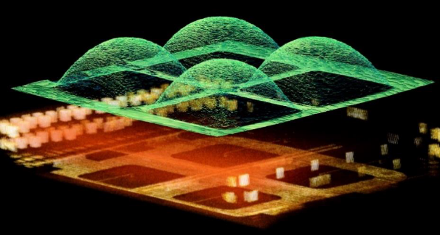
Toward planar microlenses
  Planar microlens
    Shaped by design (mask)
    « Thin » layer (<1 µm)
    Planar surface
    Gapless possibilities
    Classical lithography steps (litho-etch)
    Materials robust to reliability testing
  Melted microlens
    Adapted process for 10 µm pitch max
    « Thick » layer (few µm) dedicated to large pitch
    Topography, « dome » shape
    Shape irregularity due to variability of reflow process
    Delicate process with reliability concerns
    Sensitive to temperature
S. Pellegrini, ISSW2018

Slide 6
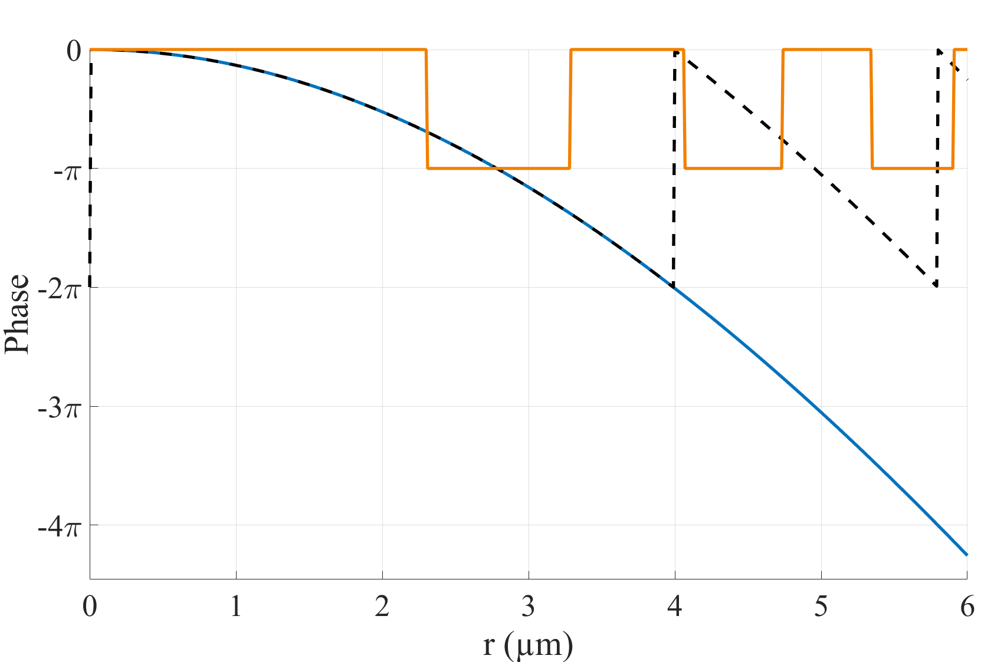
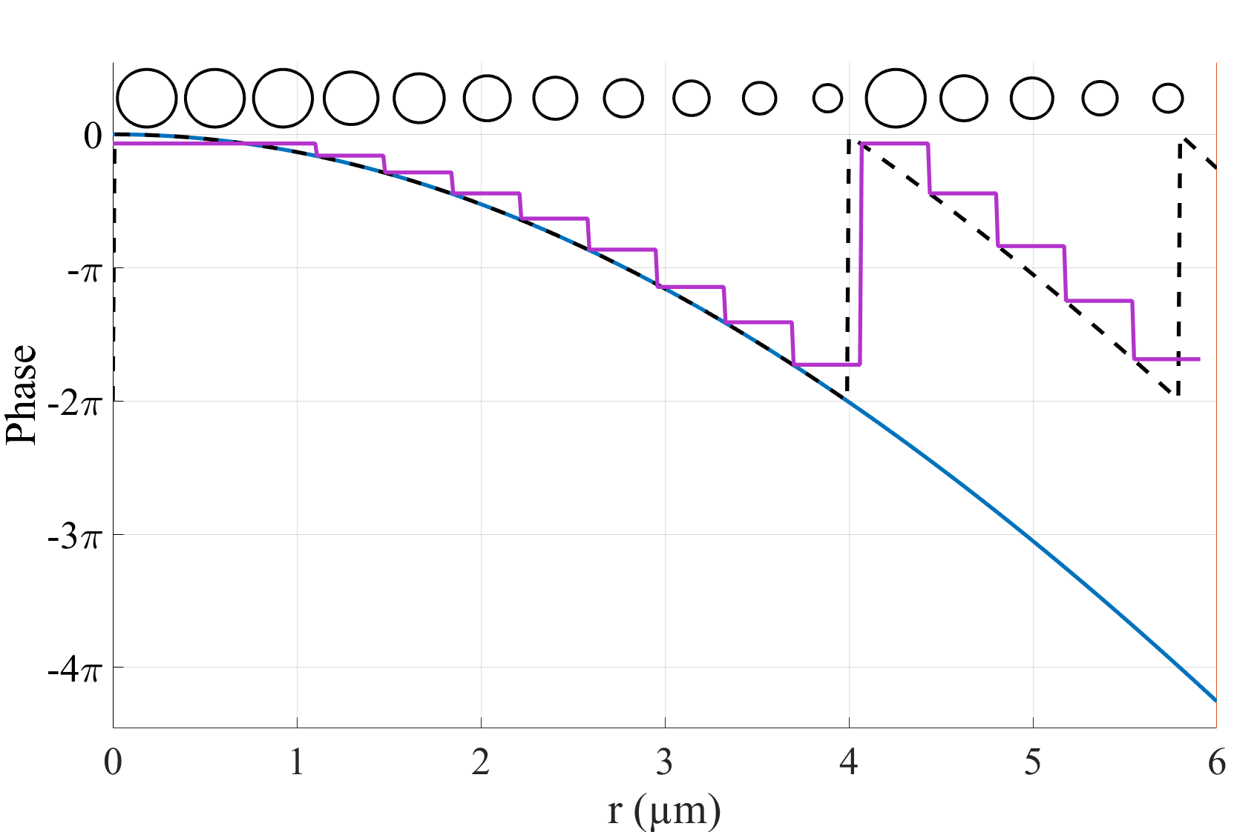

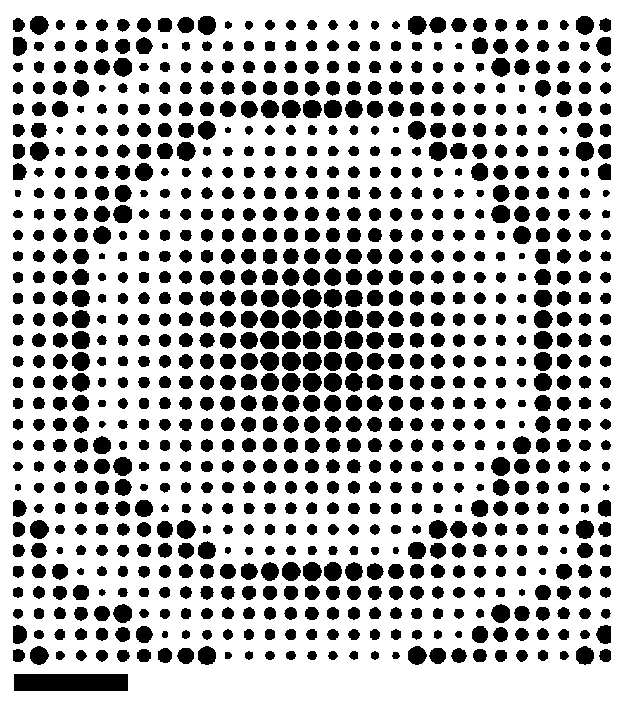

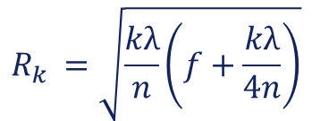
Theory basics
Fresnel Zone Plate
Metamicrolens
Nanopillars:
Arbitrary profile
Phase modulo 2π
FZP phase profile
Meta phase profile
With Plan convex profile
Binary phase, 0 – π
Radius of the k_{th} ring:
Phase gradient, 0 – 2π
Phase at position r :
f = 8 µm
λ = 940 nm
Normal incidence
n_{spacer}= 1,45
$$R_{k }=\sqrt{\frac{kλ}{n}\left(f+\frac{kλ}{4n}\right)}$$
$$φ(r)=\left[\frac{2π}{λ}\left(\sqrt{\left(r^{2}+f^{2}\right)}−f\right)\right]mod(2π)$$

Slide 7
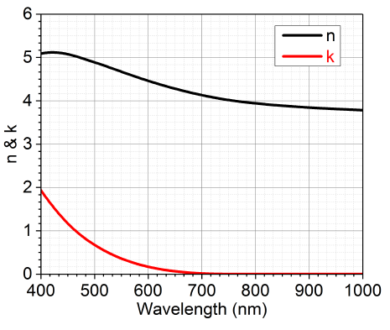
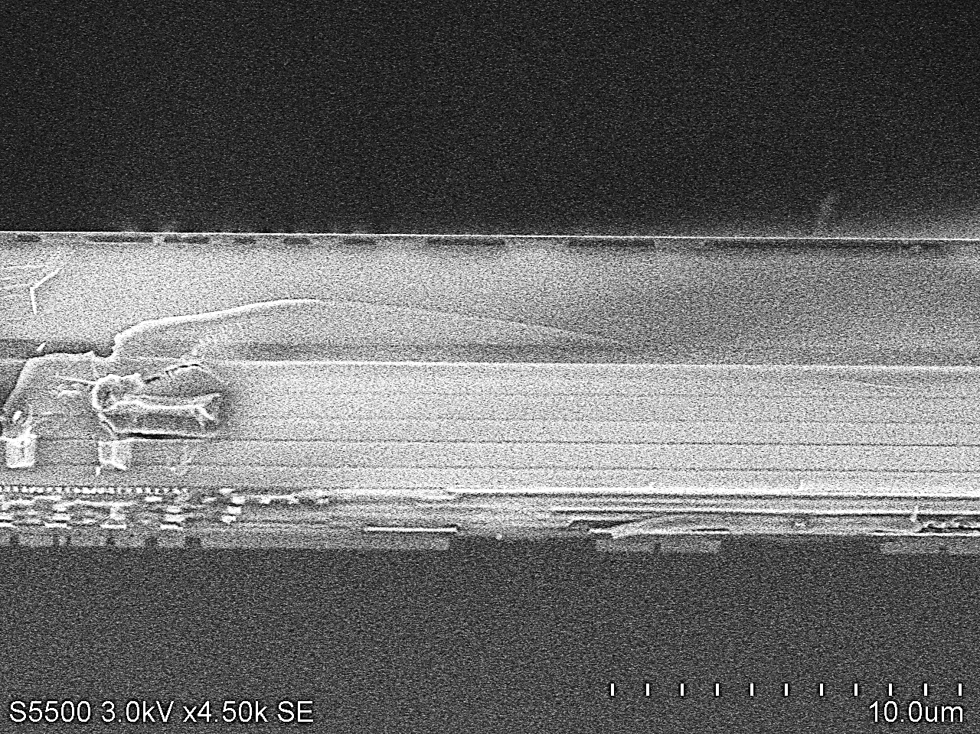

process
Process materials
  Silicon oxide spacer (2 µm to 10 µm) adjusted to focal distance and pixel size.
  Amorphous silicon, high index (3.8) for phase shift
  transparent at λ > 800 nm
  Stress minimization of the full stack (mainly aSi)
  Silicon oxide as antireflective coating
  Final planarisation
Low temperature amorphous silicon
h = 200nm a-Si
AR: SiO2
a-Si ~ 200 nm
Pedestal
SiO2 ~ 2 µm
SiN
SiN
SiO2
Backend
CMOS 300mm (C40)
Process layout cross-section
MEB cross-section

Slide 8
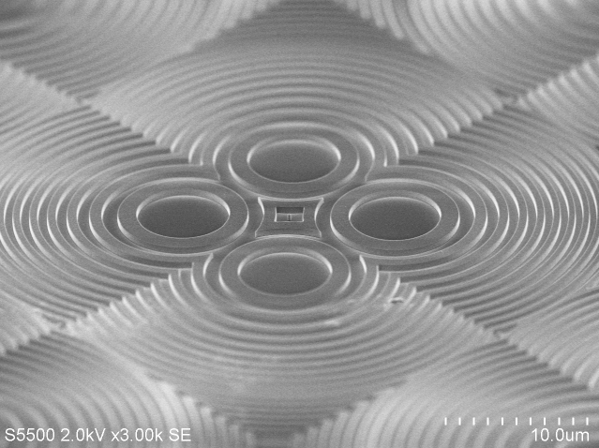
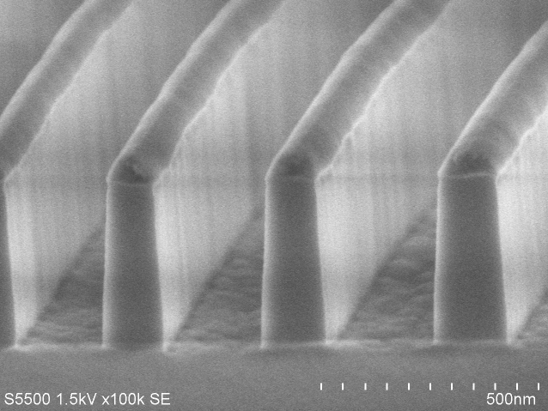
process
Patterning control
  Deep UV scanner with optical proximity correction (OPC)
  Down to 100 nm structures, up to 500 nm tall
  (Quasi) Vertical etch optimization with resist and SiO2 hard mask
  High aspect ratio filling with SiO2 (Anti reflective coating)
100 nm
Artistic view of Quad SPAD µlenses
SEM cross section before resist mask removal

Slide 9
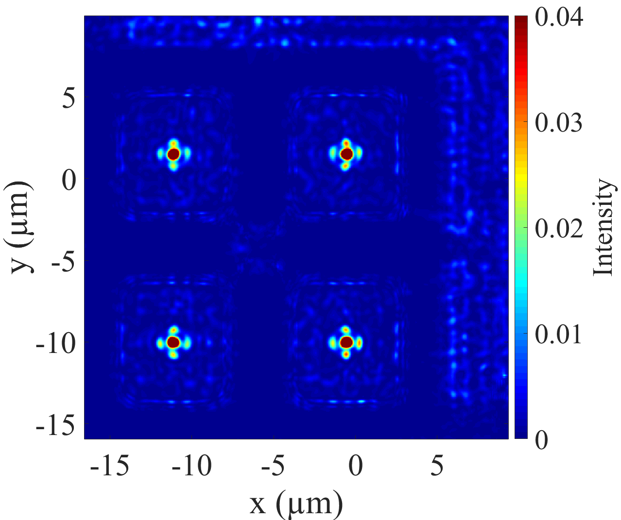
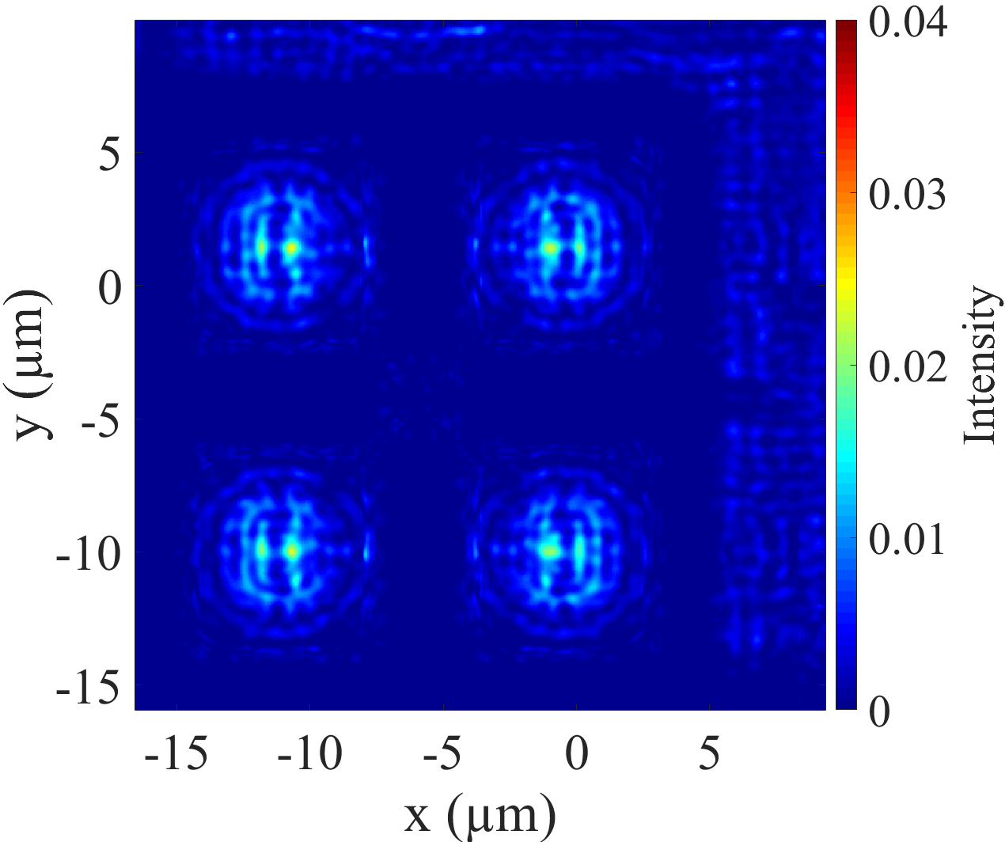
Layout and Simulation
FZP microlens
  Only h, f optimization parameters with process constraints
Key parameters:
f = 8 µm
h = 200 nm
AR = 150 nm
Metamicrolens
  Choice of pitch (process)
  Define library of pillars
  with 0 to 2π phase shift
  Optimization on h, f, pillars/pitch
2 µm
Key parameters:
f = 8 µm
h = 500 nm
pitch = 370 nm
Phase : 0 to 2π
2 µm

Slide 10
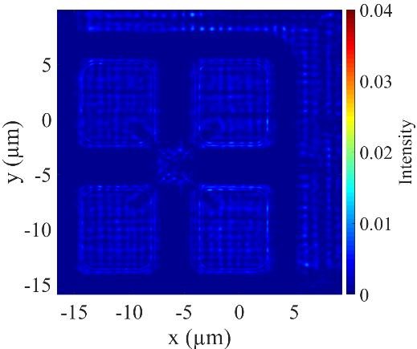
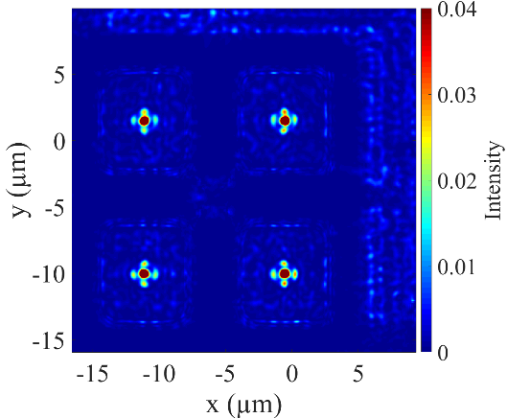


Simulated performances
None
FZP
Melted
Meta
Microlens type | None | FZP | Melted | Meta
Simulated PDE (%) | 2,2 ± 0,2 | 2,6 ± 0,1 | 3,4 ± 0,2 | 4,1 ± 0,1
Average gain | – | x 1,2 | x 1,5 | x1,8
PDE: Photon Detection Efficiency on pixel pitch
Maximum gain (ff_{O}=40%) = S_{pixel} / S_{SPAD metal Shield} = x 2,5

Slide 11
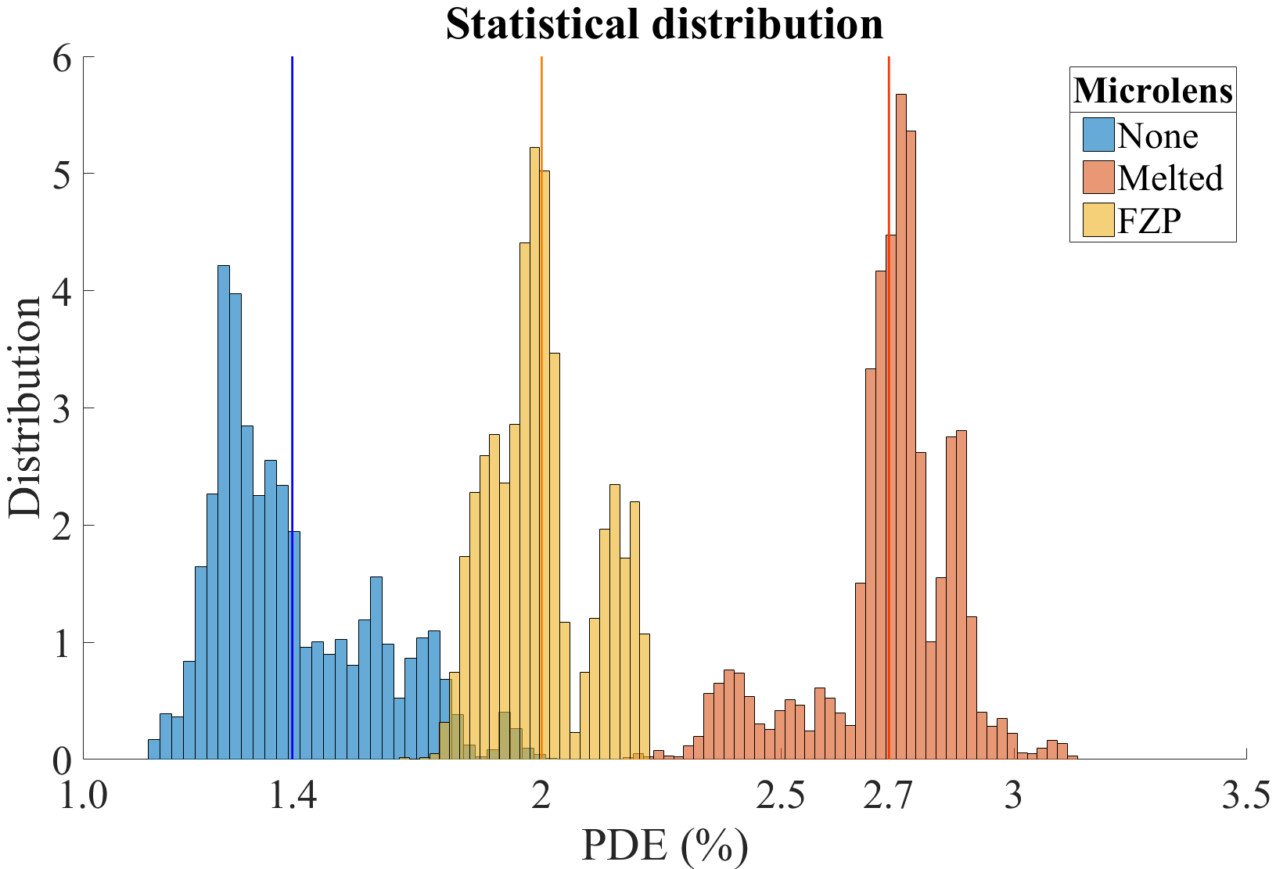
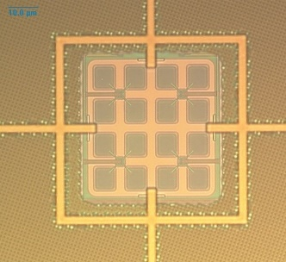
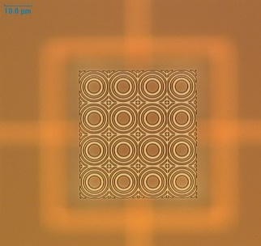
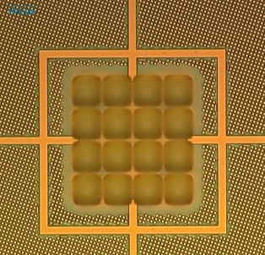
Characterization results
X 1,4
X 1,9
λ = 940 ± 5 nm
Open at f/2
Statistics:
Melted: 18 816 pixels
No lens: 5632 pixels
FZP : 2816 Pixels
No microlens
FZP microlens
Melted microlens

Slide 12
Characterization results
X 1,4
X 1,9
λ = 940 ± 5 nm
Open at f/2
Statistics:
Melted: 18 816 pixels
No lens: 5632 pixels
FZP : 2816 Pixels
No microlens
FZP microlens
Melted microlens

Slide 13
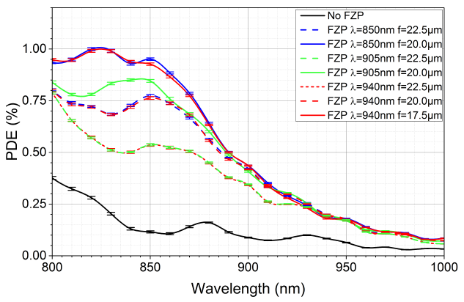
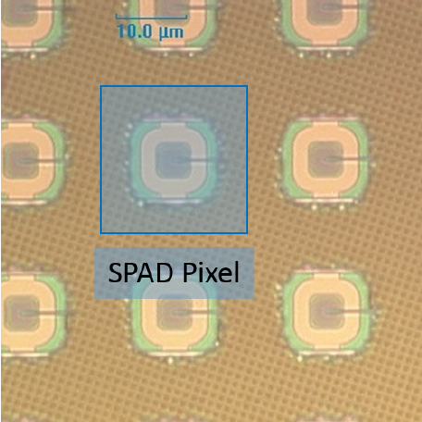
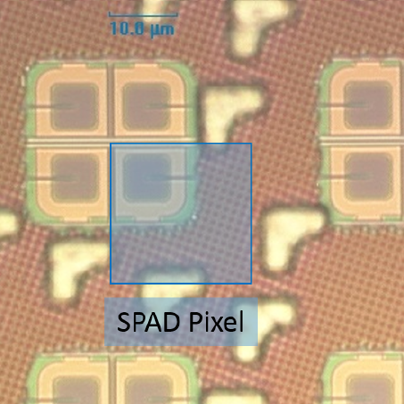
Previous results on large pitch arrays
Tested SPAD arrays
  Isolated SPADs 21.6 µm pitch and Quad SPAD (2x2 SPAD) pixels
  Large Microlens on total pitch not available in reflow process
  Off axis optical center
x 5,3
Isolated SPAD
x 2,4
FZP µlens | Gain @ 940 nm | S_{pixel}* /S_{SPAD}
Isolated SPAD | x 2,4 ±0,1 | 21
Quad SPAD | x 1,7 ±0,1 | 8
Isolated SPAD
21.6 µm pitch, 5% ff_{o}
4.7 µm metal shield opening
Quad SPAD
2x2 SPAD macropixel
21.6 µm pitch, 12% ff_{o}
7.5 µm metal shield opening
*Presence of metals in light path

Slide 14
Conclusion
Planar microlens
  Some process and stability advantages
  Predictive simulations : Require a tight description of stack materials and layout
  (f/2 aperture, neighborhood to be included)
  Arbitrary lens shape
  Low limit ~5 µm pitch, large pitch must be confirmed
  940 nm much more difficult than 850 nm wavelength
FZP microlens
  Gain lower than melted microlens
  Process successfully developed
Metamicrolens
  Gain should be close to melted microlens
  Process under development

